Slide 1


Lesson 10
Films
UNIT 2

Slide 2

AAAND ACTION!
Do you love watching films? Why?
What is the last film you have seen on TV?
What is the funniest film you have ever seen?
And what about the most unusual one?
Do you watch films at home or in the cinema?

Slide 3
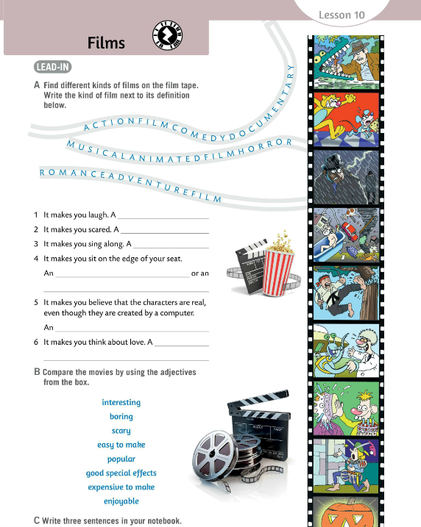

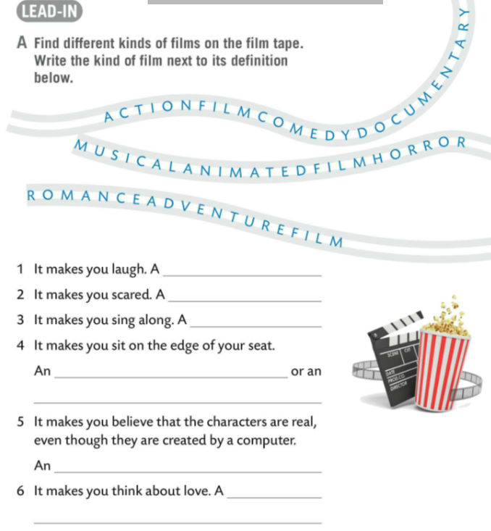
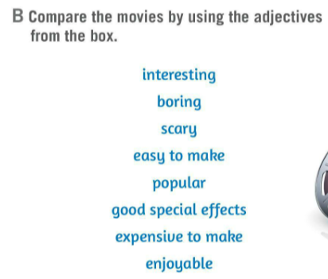
Look at the film tape on the side of the book. What kind of films can you see. Do Task A.
Check.
comedy
horror
Look at the adjectives in Task B. Compare the movies using the ajdectives from the box.
musical
adventure film
action film
animated film
Check.
romance
Write three sentences in your notebook.

Slide 4
Do you know the meaning of the words in Task B? Use the dictionary at the back of your book.
Check.
interesting – zanimljiv
boring – dosadan
scary – zastrašujući
easy to make – jednostavan za izraditi
popular – popularan
good special effects – dobri specijalni efekti
expensive to make – skup za izraditi
enjoyable – ugodan

Slide 5
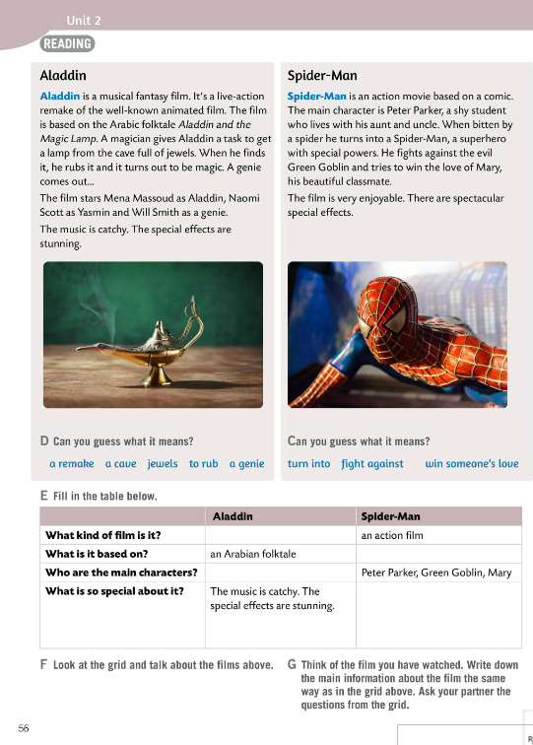
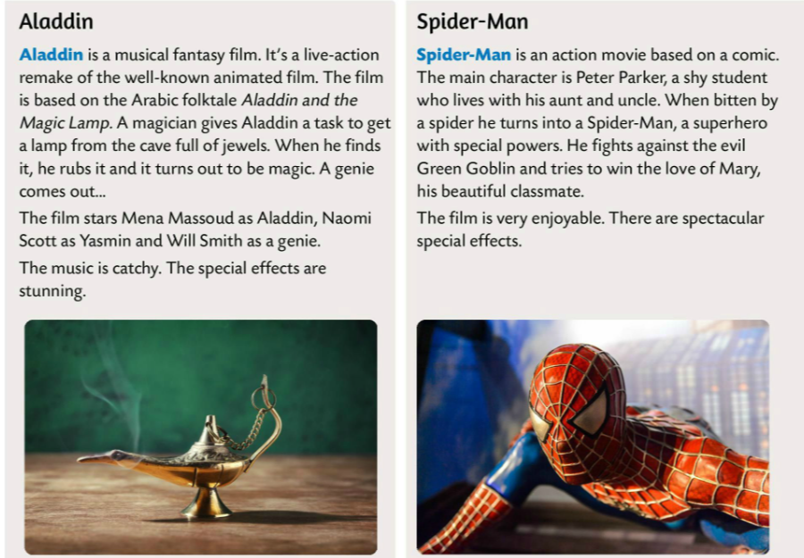
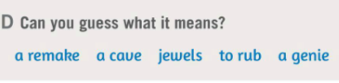

Read the text about the Aladdin and Spider-Man films.
Do Task D. What do these words mean? Use the dictionary if neccessary.
Check.
a remake – obrada
a cave – špilja
jewels – drago kamenje, dragulji
to rub – trljati
a genie – duh
turn into – pretvoriti (se) u što
fight against – boriti se protiv
win someone’s love – pridobiti nečiju ljubav

Slide 6
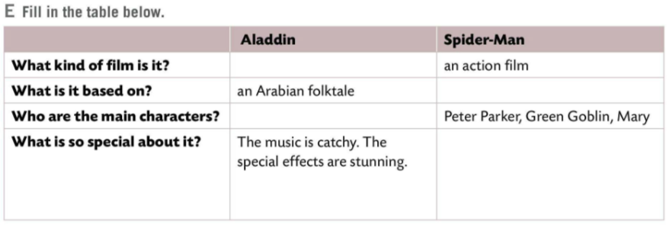
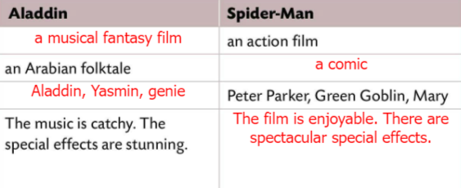
Read the texts one more time and fill in the table in Task E.
Check.
Look at the grid and talk about the films above.
Do Task G.
Write your own grid with the information about the film you have watched. Ask your partner the questions from the grid.

Slide 7
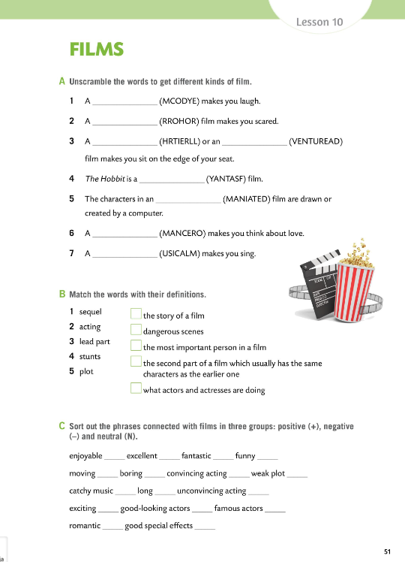

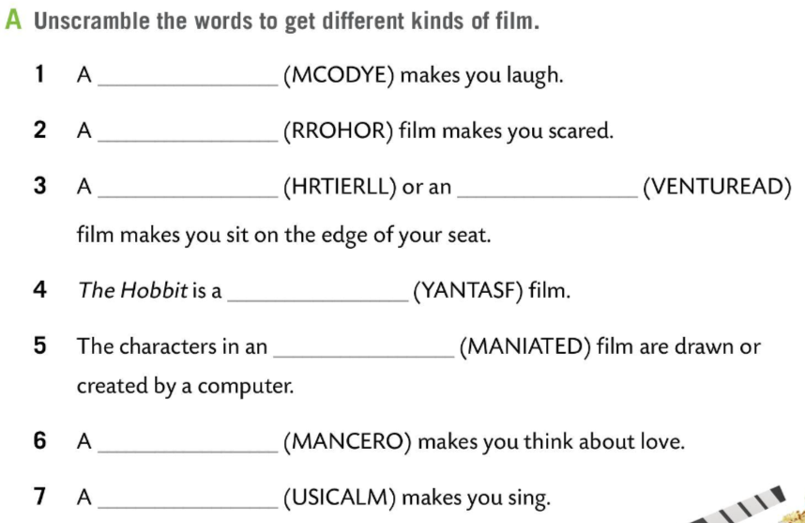
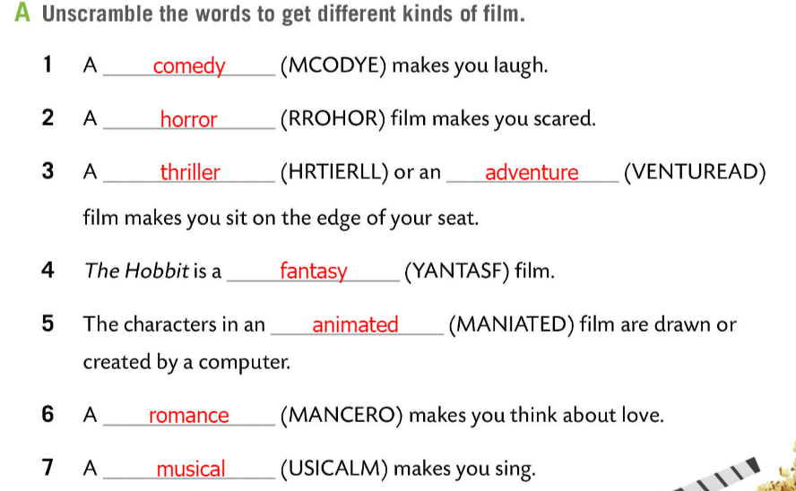
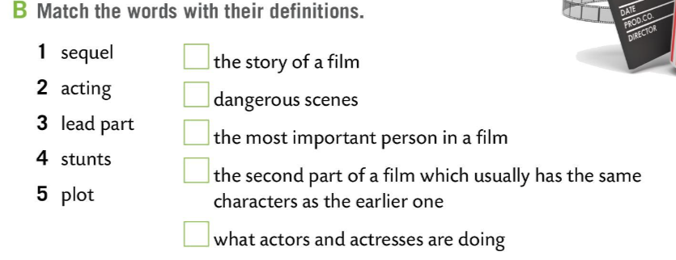
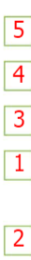
Workbook, page 51.
Unscramble the words to get different kinds of film in Task A.
Check.
Match the words in Task B with their definitions.
Check.
sequel – nastavak
acting – gluma
lead part – glavna uloga
stunt – kaskaderska scena
plot – radnja

Slide 8
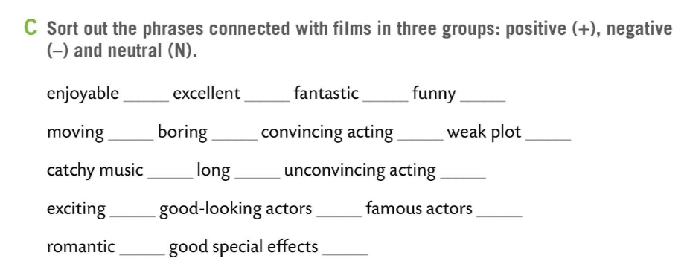
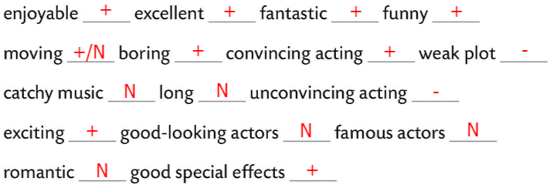
Workbook, page 51.
Do Task C. Sort out the phrases connected with the films in three groups: positive (+), negative (-) and neutral (N).
-
Check.
Organize a short classroom competition. Play the game and check your knowledge on film genres.
https://wordwall.net/play/511/072/212

Slide 9
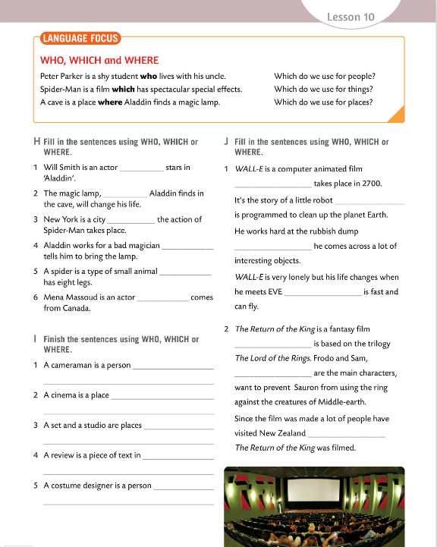
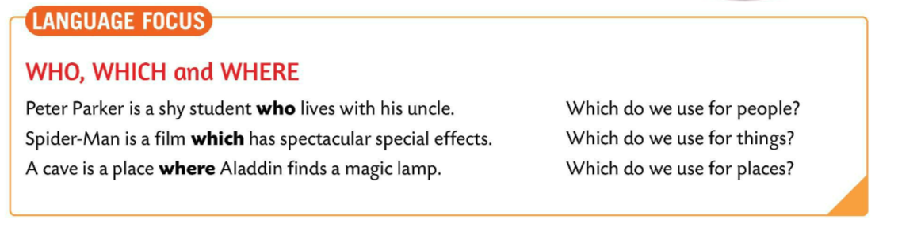
LANGUAGE FOCUS
Relative pronouns
describes the noun or pronoun.
Odnosne zamjenice koristimo kako bi povezali rečenicu ili izraz s imenicom ili zamjenicom. Služe kako bi pobliže opisale imenicu ili zamjenicu.
The most common relative pronouns are who, whom, whose, which, and that.
Look at the examples and try to answer the questions on the side.

Slide 10
Peter Parker is a shy student WHO lives with his uncle.
(…who lives with his uncle → describes a person.)
WHO is used for people. It replaces subject pronouns like I, she, he, we, they.
WHO - za osobe (I, she, he, we, they)
Spider-Man is a film WHICH has spectacular special effects.
(…which has spectacular special effects describes a thing – a film.)
WHICH is used for things. It replaces objects and animals.
WHICH - za stvari i životinje

Slide 11
A cave is a place WHERE Aladdin finds a magic lamp.
(…where Aladdin finds a magic lamp → describes a place.)
WHERE is used for places.
WHERE – za mjesta.

Slide 12
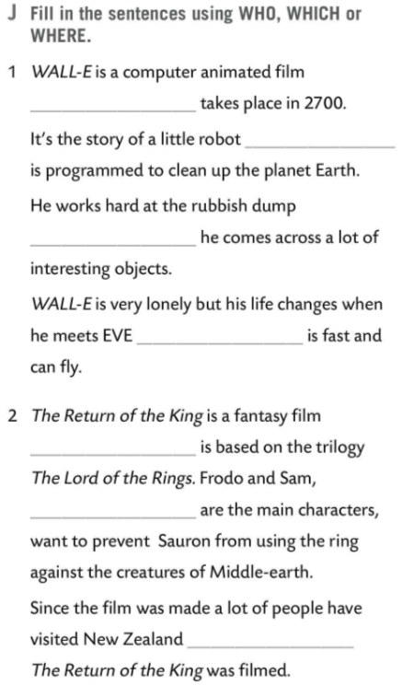
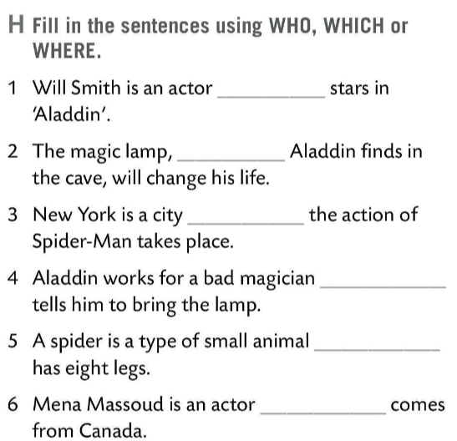
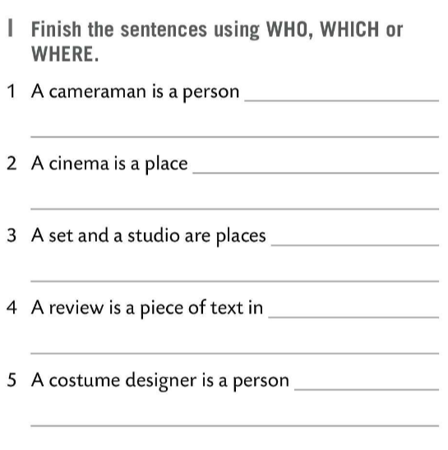
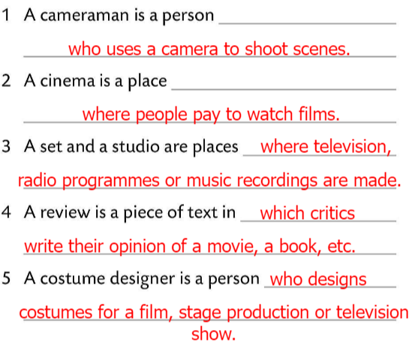
Fill in the sentence in Task H using WHO, WHICH or WHERE.
WHICH
Check.
WHO
Finish the sentences in Task I using WHO, WHICH or WHERE.
WHO
WHERE
Check.
WHICH
WHO
Fill in the sentences in Task J using WHO, WHICH or WHERE.
WHERE
WHO
Check.
WHICH
WHICH
Play this game in 4 groups and test your knowledge. https://wordwall.net/play/7672/877/785
WHO
WHO
WHERE

Slide 13
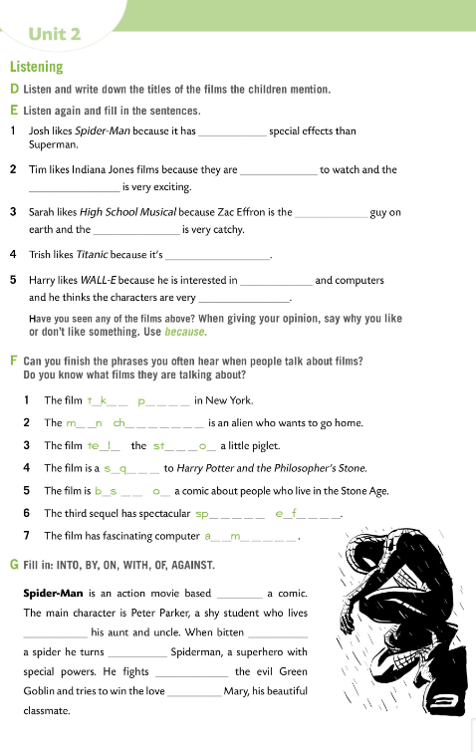

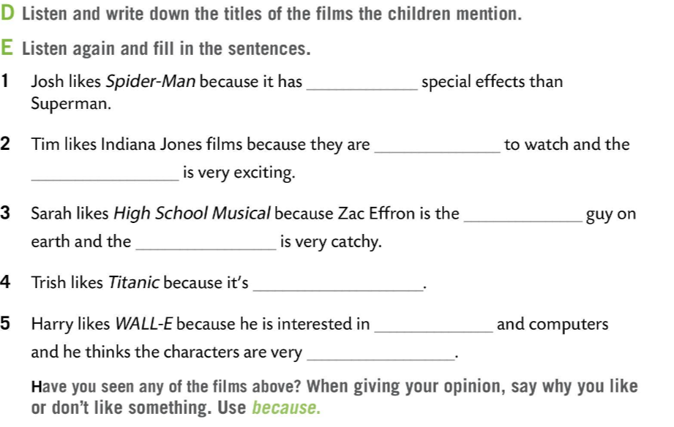
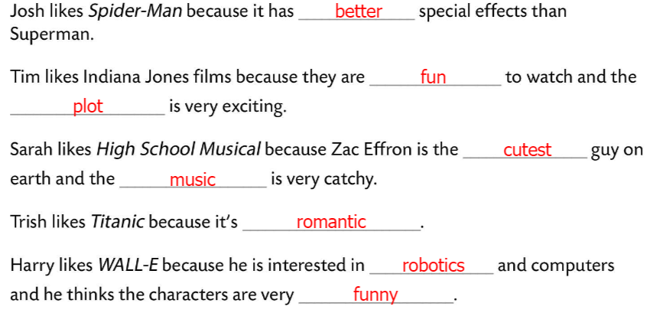

Workbook, page 52.
Do Task D. Listen and write down the titles of the films.
Check.
Superman and Spider-Man, Indiana Joness, High School Musical, Titanic, WALL-E
Listen again and fill in the sentences in Task E.
Check and give your opinion on the films above. Use because.

Slide 14
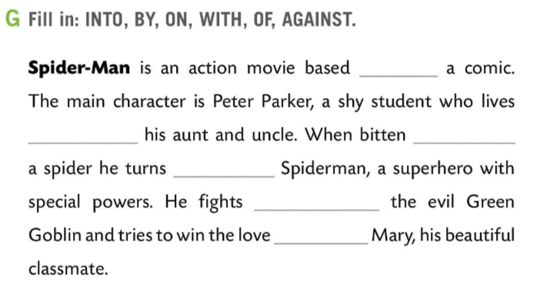
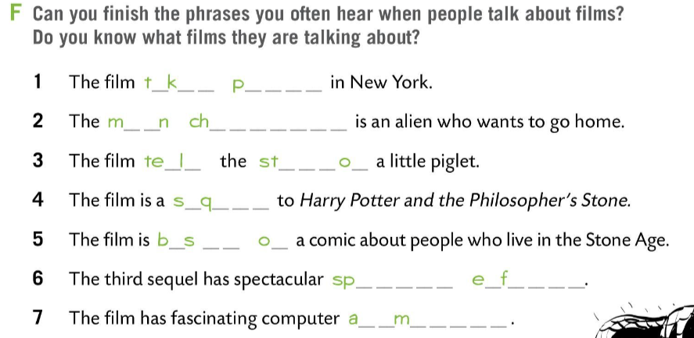
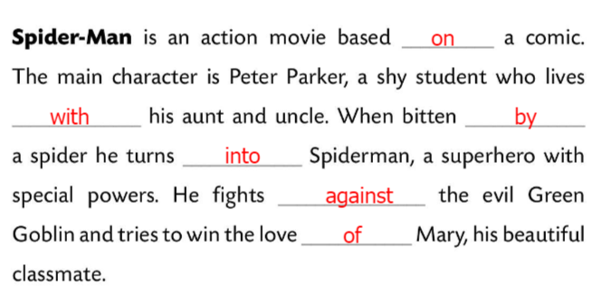
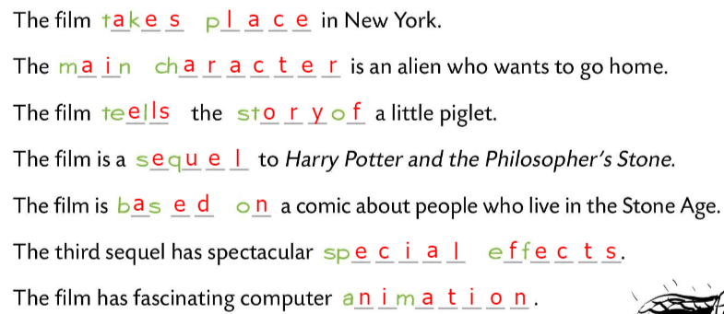
Workbook, page 52.
Can you finish the phrases in Task C? Do you know what films are they talking about?
Check.
Fill in the sentences in Task G. Use: INTO, BY, ON, WITH, OF, AGAINST.
Check.

Slide 15
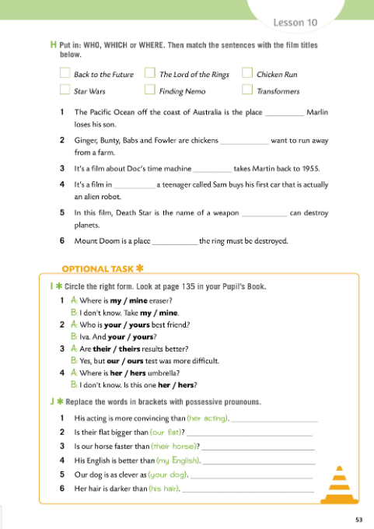
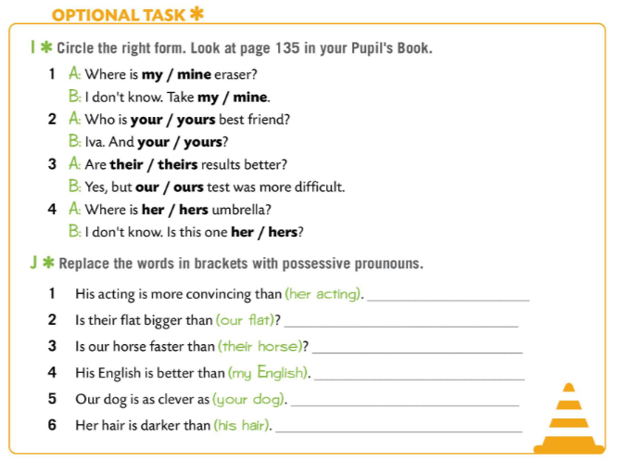
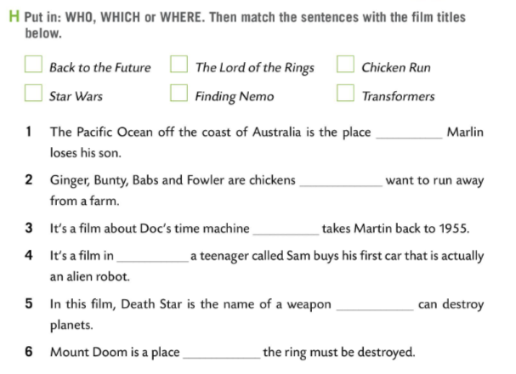
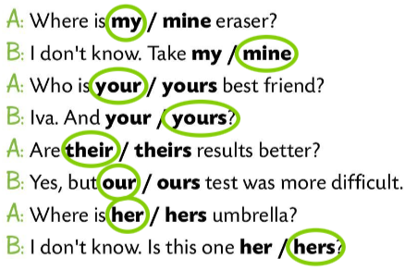
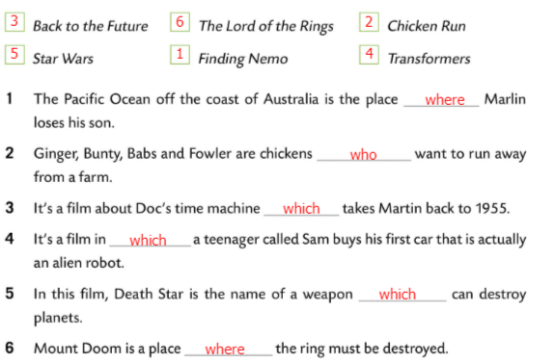
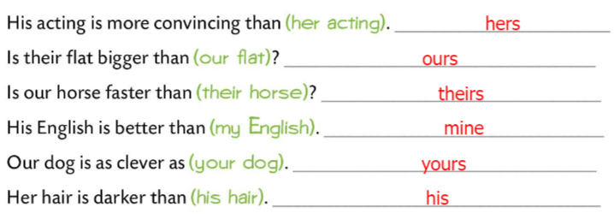
Workbook, page 53.
Fill in the sentences in Task H using WHO, WHICH, or WHERE. Match the sentences with the film titles.
Check.
Circle the right form in Task I. Look at page 135 in your Pupil’s Book.
Check.
Replace the words in brackets with possessive pronouns in Task J.
Check.

